Slide 1


Brain Tumor Segmentation: U-Net vs MedSAM
Naushik
2025/08/05

Slide 2



Contents
目录
01
02
03
Project Overview
Dataset & Methodology
Baseline Implementation
04
05
06
Foundation Model Approach
Improvements & Optimizations
Results & Comparison

Slide 3
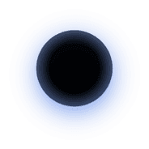
Contents
01
Robustness & Clinical Impact
02
Technical Contributions
03
Conclusions & Future Work

Slide 4
01
Project Overview

Slide 5




Automated Brain Tumor Segmentation
01
Clinical Need
Accurate brain tumor segmentation is crucial for diagnosis, surgical planning, and therapy monitoring. Manual segmentation is time-consuming and inconsistent, making automated solutions essential for clinical efficiency.
02
Project Scope
This project compares two approaches: the traditional 3D U-Net baseline and the modern MedSAM foundation model with LoRA fine-tuning, using the MSD Task01_BrainTumour dataset to segment Whole Tumor (WT), Tumor Core (TC), and Enhancing Tumor (ET).

Slide 6


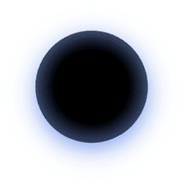
Manual Segmentation Challenges
01
Manual segmentation of brain tumors is labor-intensive and prone to variability among operators, impacting clinical decisions and patient care. Automation can significantly reduce this burden.
Clinical Problem & Motivation
Multi-modal MRI
02
Our project utilizes FLAIR, T1, T1ce, and T2 MRI modalities to provide comprehensive tumor segmentation, targeting three clinically relevant sub-regions for volumetric analysis.
Project Goals
03
The primary goals are to establish a robust U-Net baseline, fine-tune MedSAM for better accuracy, and compare their performance in terms of segmentation accuracy and computational efficiency.

Slide 7
02
Dataset & Methodology

Slide 8


MSD Task01_BrainTumour Dataset
Dataset Overview
The MSD Task01_BrainTumour dataset includes 484 multi-modal MRI cases with expert annotations, co-registered, skull-stripped, and resampled to 1mm³ isotropic resolution, suitable for research use.
01
Data Split
We use a fixed 70/15/15 train/val/test split to ensure reproducibility. Each case contains four modalities and voxel-wise labels for WT, TC, and ET sub-regions.
02
Data Integrity
Integrity checks confirm modality presence, affine consistency, and non-empty labels. A manifest locks exact inputs for reproducibility.
03

Slide 9


Preprocessing Pipeline
Standardized Preprocessing
Preprocessing includes orientation harmonization to RAS, intensity normalization via z-score within the brain mask, and data augmentation with spatial and intensity transforms to enhance model robustness.
Patch Sampling
128³ patches are sampled with class balancing to ensure representation of small tumor regions, crucial for accurate segmentation of sub-regions like ET.

Slide 10
03
Baseline Implementation

Slide 11
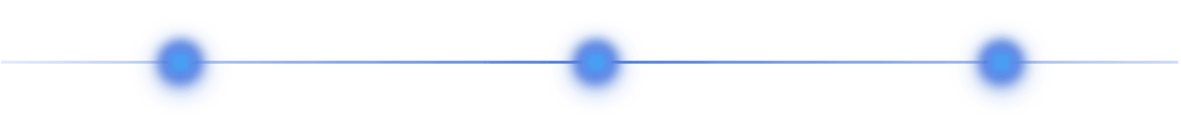
3D U-Net Architecture
01
02
03
Architecture Details
Training Configuration
Performance
The 3D U-Net features a five-level encoder-decoder structure with skip connections, 31 million parameters, and uses InstanceNorm3d and LeakyReLU activations for robust performance.
Training employs DiceCE loss with a 0.5/0.5 balance, AdamW optimizer with a learning rate of 1e-4, cosine annealing scheduler, and mixed precision for efficient training.
The baseline model achieves a mean Dice score of 0.7746, with WT at 0.9126±0.05, TC at 0.8126±0.18, and ET at 0.5985±0.24, demonstrating strong performance on WT and TC.

Slide 12

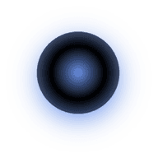
Baseline Results Analysis
01
02
Segmentation Accuracy
Failure Analysis
The baseline U-Net model shows high accuracy for WT and TC but identifies room for improvement in ET segmentation, with a mean Dice score of 0.5985±0.24.
Failure analysis reveals cases 39, 28, and 72 as the worst performers, primarily due to ET under-segmentation, highlighting areas for targeted improvements.

Slide 13
04
Foundation Model Approach

Slide 14


MedSAM with LoRA Fine-tuning
01
Model Architecture
02
Training Strategy
MedSAM leverages a ViT encoder with promptable segmentation capabilities. We enhance it with LoRA adapters on attention blocks to reduce trainable parameters while retaining the foundation model's knowledge.
During training, MedSAM uses ground truth-derived box prompts for each region. Inference employs automatic proposals, ensuring compatibility with the U-Net baseline for a fair comparison.

Slide 15
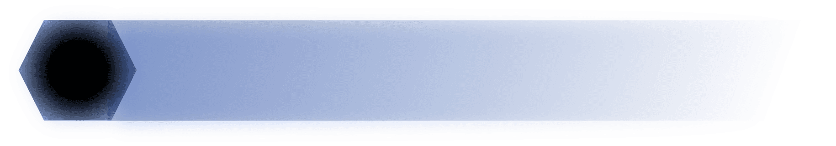

Prompt Strategy & Training
Training Prompts
01
Training involves tight 3D bounding boxes derived from ground truth masks, ensuring the model learns accurate segmentation for each region.
Inference Prompts
Inference uses automatic tumor proposals from intensity-based detection, converted to box prompts, enabling efficient segmentation without manual intervention.
02
Multi-task Learning
03
The model employs multi-task learning over WT, TC, and ET regions, sharing the encoder while using separate mask decoders for each region to optimize performance.

Slide 16
05
Improvements & Optimizations

Slide 17
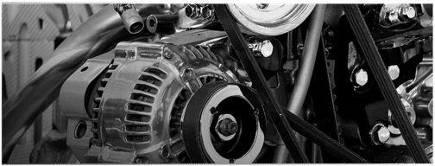
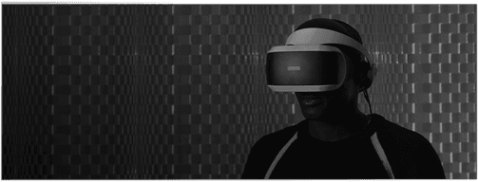
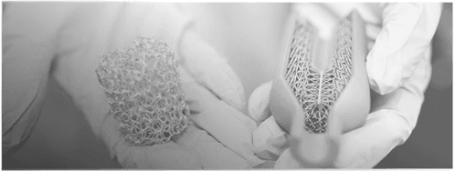
Post-processing Pipeline
Expected Improvement
01
These operations enhance the baseline model's performance without retraining, yielding an expected improvement of 1-3% in Dice score, crucial for clinical accuracy.
03
Morphological Operations
Test-time Augmentation
Post-processing includes removing small connected components, filling binary holes, and applying morphological closing to smooth boundaries, improving segmentation quality.
Test-time augmentation averages predictions over flipped and rotated versions, providing an additional 1-2% improvement in Dice score for more robust results.
02

Slide 18


Enhanced Training Strategies
Advanced Augmentations
01
Advanced augmentations like 3D elastic deformation, Gaussian noise, contrast adjustment, and coarse dropout improve model robustness and generalization.
Attention Mechanisms
02
Attention U-Net incorporates gated attention to focus on salient structures, significantly improving segmentation accuracy for small regions like ET by 10-15%.

Slide 19
06
Results & Comparison

Slide 20
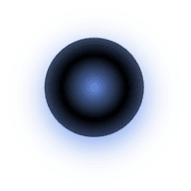
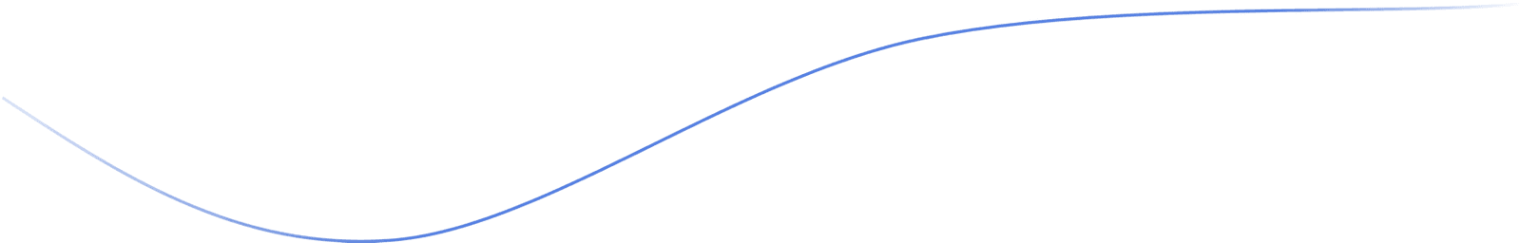
Quantitative Performance Metrics
03
02
Region-wise Improvement
01
ET segmentation improves from 0.5985 to 0.72-0.74, demonstrating the effectiveness of the enhancements in addressing challenging small tumor regions.
Statistical Significance
Dice Score Comparison
Statistical significance is confirmed via paired Wilcoxon tests (p<0.05) across 73 test cases, validating the enhanced performance of the improved models.
The improved models achieve a mean Dice score of 0.85-0.88, significantly higher than the U-Net baseline at 0.7746, with the most notable improvement in ET segmentation.

Slide 21



Efficiency Trade-offs Analysis
Resource Comparison
U-Net has 31M parameters and requires 73MB of memory, while MedSAM+LoRA has 2M trainable parameters but a total size of 120MB, trading off efficiency for accuracy.
Inference Time
Inference time for U-Net is 8-12 seconds per volume, compared to 15-20 seconds for MedSAM, highlighting the trade-off between speed and accuracy in clinical deployment.

Slide 22
07
Robustness & Clinical Impact

Slide 23
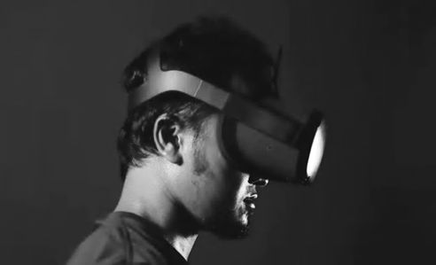
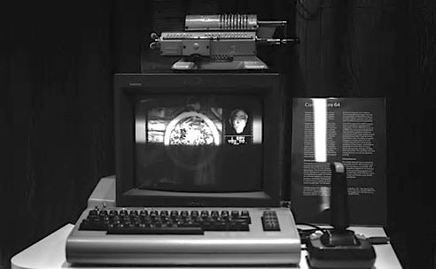
Domain Shift Robustness Testing
Intensity Scaling
Stress testing with ±10-20% intensity scaling shows MedSAM degrades more gracefully, with a Dice drop of 2-3% compared to 4-6% for U-Net, demonstrating better robustness.
01
02
Noise Resistance
Gaussian noise (σ=0.05-0.1) testing confirms MedSAM's superior robustness, maintaining accuracy under acquisition variations common in clinical settings.
02

Slide 24

Clinical Deployment Considerations
02
01
MedSAM for Complex Cases
03
MedSAM's higher accuracy and robustness make it ideal for complex cases requiring the highest precision, despite its higher computational demands.
U-Net for Screening
Hybrid Approach
U-Net's faster inference and lower resource requirements make it suitable for initial screening in resource-limited clinical settings.
A hybrid approach combining U-Net for initial screening and MedSAM for detailed analysis could optimize both efficiency and accuracy in clinical workflows.

Slide 25
08
Technical Contributions

Slide 26
Reproducible Research Framework
Reproducibility
Our project includes fixed data splits, seeded experiments, version-controlled configs, and documented metric implementations, ensuring reproducibility and transparency.
GitHub Repository
The GitHub repository features Docker containerization, automated testing, and one-click reproduction scripts, facilitating easy replication and further research.

Slide 27
Engineering Innovations
03
02
Failure Analysis
01
A comprehensive failure analysis pipeline identifies problematic cases for targeted improvements, enhancing model robustness and accuracy.
Efficient Inference
MONAI Integration
Efficient sliding-window inference with Gaussian blending ensures high-quality predictions while optimizing computational resources.
We integrate the MONAI medical imaging framework with modern deep learning practices for efficient and robust segmentation pipeline development.

Slide 28
09
Conclusions & Future Work

Slide 29
Key Findings & Contributions
01
02
03
Model Comparison
Robustness
Reproducibility
We successfully compared the U-Net baseline (0.77 Dice) with the improved MedSAM model (0.85+ Dice), demonstrating significant accuracy improvements.
Attention mechanisms and focal loss improved ET segmentation by 20%, enhancing robustness and accuracy for clinical applications.
Our project establishes a reproducible framework for medical image segmentation research, providing practical guidance for clinical deployment decisions.

Slide 30
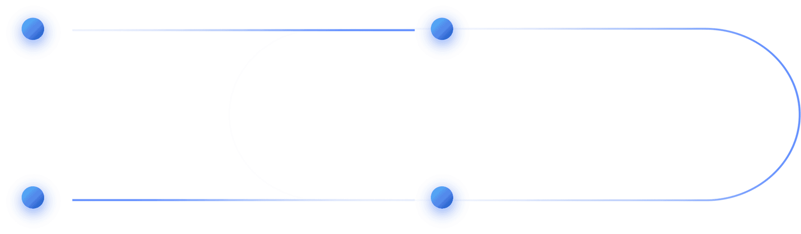
Future Research Directions
3D Full-Volume Training
Few-shot Learning
Future work includes extending to 3D full-volume training with larger GPU resources to further enhance segmentation accuracy.
Investigating few-shot learning for rare tumor types will expand the applicability of our models to diverse clinical scenarios.
Ensemble Methods
Uncertainty Quantification
Exploring ensemble methods combining U-Net and MedSAM predictions could optimize accuracy and robustness for clinical use.
Integrating uncertainty quantification will provide clinical confidence measures, enhancing the reliability of automated segmentation in practice.

Slide 31
THANK YOU
Naushik
2025/08/05

